Slide 1
Deploy core Microservices to EKS Cluster

Slide 2
EKS cluster:-
Amazon Elastic Kubernetes Service (EKS) is a cloud-based container management service that natively integrates with Kubernetes to deploy applications. The EKS service automatically manages and scales clusters of infrastructure resources on AWS with Kubernetes.
EKS cluster can be created in following ways:
1. AWS console
2. AWS CLI
3. eksctl command
4. using Terraform

Slide 3
Control Plane:- Amazon EKS ensures every cluster has its own unique Kubernetes control plane. This design keeps each cluster’s infrastructure separate, with no overlaps between clusters or AWS accounts. Control Plane Managed by EKS, it consists of Kubernetes API server nodes and an etcd cluster. Worker Nodes:- Worker nodes in EKS are the EC2 instances that run the Kubernetes Pods. A Pod is the smallest deployable unit in Kubernetes and can contain one or more containers. These nodes are part of the EKS Cluster and communicate with the control plane to receive instructions on which containers to run and where to run them.

Slide 4
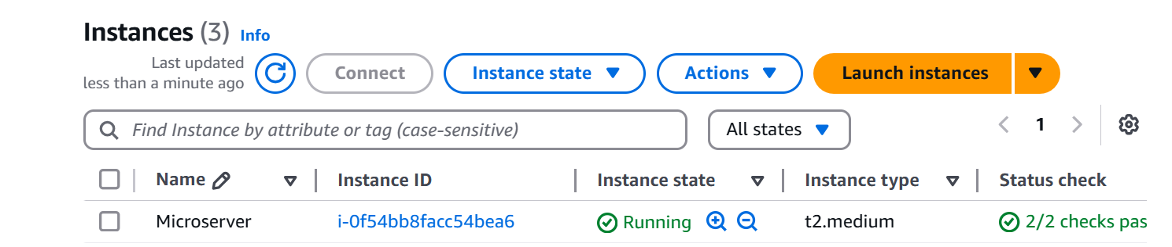
Instance Creation:- Create an ec2 instance using Ubuntu and connect the instance to git bash Install the necessary tools in gitbash like Install the Jenkins :- Change Host Name to Jenkins sudo hostname jenkins Perform update first sudo apt update

Slide 5
Install Java 11 sudo apt install default-jdk –y Verify Java Version java -version Install Maven sudo apt install maven -y you can type mvn --version you should see the below output. Now lets start the Jenkins installation Add Repository key to the system curl -fsSL https://pkg.jenkins.io/debian/jenkins.io-2023.key | sudo tee \ /usr/share/keyrings/jenkins-keyring.asc > /dev/null Append debian package repo address to the system echo deb [signed-by=/usr/share/keyrings/jenkins-keyring.asc] \ https://pkg.jenkins.io/debian binary/ | sudo tee \ /etc/apt/sources.list.d/jenkins.list > /dev/null

Slide 6
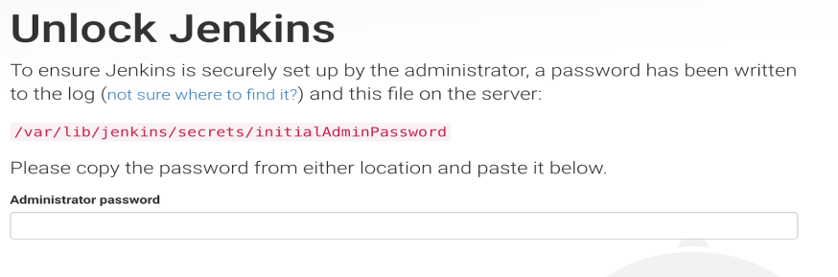
Update Ubuntu package sudo apt update Install Jenkins sudo apt install jenkins -y Access Jenkins in web browser Now copy the public ID with the Jenkins port no 8080 and paste the ID in Google to access the Jenkins Dashboard To get the initial password from the below file sudo cat /var/lib/jenkins/secrets/initialAdminPassword

Slide 7
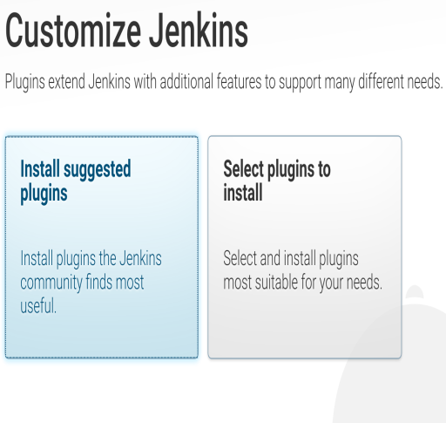
Copy the password and paste in the browser Then click on install suggested plug-ins. Also create user name and password. enter everything as admin. at least user name as admin password as admin Now Install AWS CLI:- curl "https://awscli.amazonaws.com/awscli-exe-linux-x86_64.zip" -o "awscliv2.zip" sudo apt install unzip

Slide 8

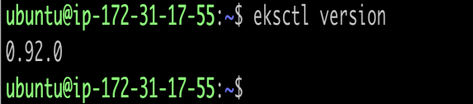
sudo unzip awscliv2.zip sudo ./aws/install aws –version Now Install Install eksctl:- Download and extract the latest release of eksctl with the following command. curl --silent --location "https://github.com/weaveworks/eksctl/releases/latest/download/eksctl_$(uname -s)_amd64.tar.gz" | tar xz -C /tmp Move the extracted binary to /usr/local/bin. sudo mv /tmp/eksctl /usr/local/bin eksctl version

Slide 9
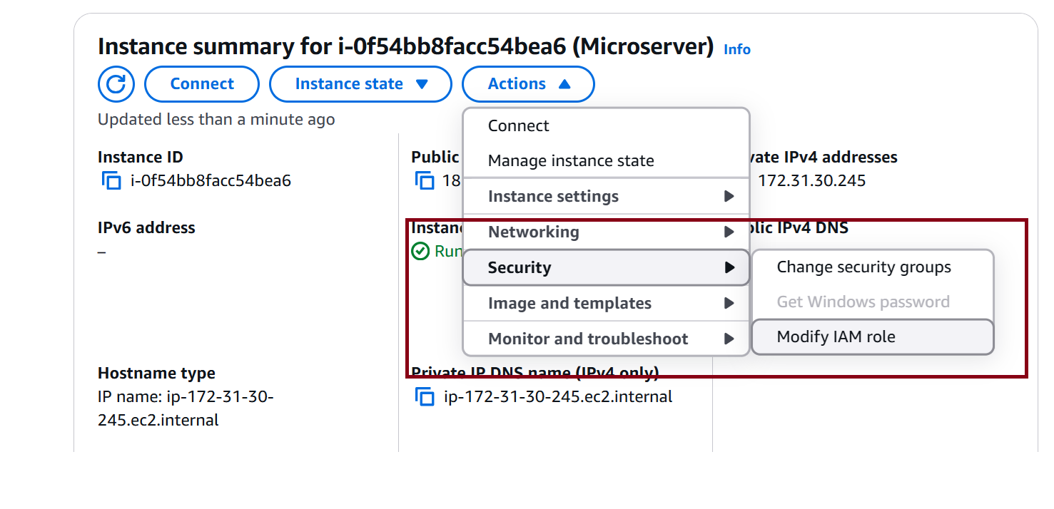
Now Install kubectl on Ubuntu Instance:- Kubernetes uses a command line utility called kubectl for communicating with the cluster API server. It is tool for controlling Kubernetes clusters sudo curl --silent --location -o /usr/local/bin/kubectl https://s3.us-west-2.amazonaws.com/amazon-eks/1.22.6/2022-03-09/bin/linux/amd64/kubectl sudo chmod +x /usr/local/bin/kubectl Verify if kubectl got installed kubectl version --short –client → Now Create IAM Role and Attach it to the running Instance

Slide 10
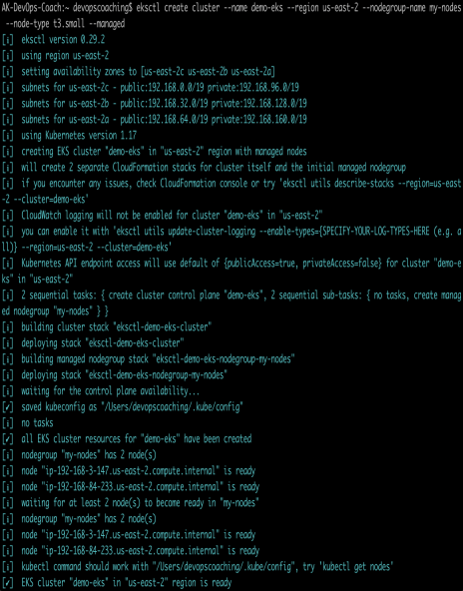
Now switch to Jenkins user → sudo su – Jenkins Now create EKS Cluster with two worker nodes using eksctl command eksctl create cluster --name demo-eks --region us-east-1 --nodegroup-name my-nodes --node-type t3.small --managed --nodes 2 the above command should create a EKS cluster in AWS it might take 15 to 20 mins. The eksctl tool uses CloudFormation under the hood, creating one stack for the EKS master control plane and another stack for the worker nodes.

Slide 11
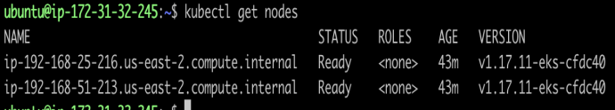
eksctl get cluster --name demo-eks --region us-east-1 This should confirm that EKS cluster is up and running. Update Kube config by entering below command: aws eks update-kubeconfig --name demo-eks --region us-east-1 kubeconfig file be updated under /var/lib/jenkins/.kube folder. you can view the kubeconfig file by entering the below command: cat /var/lib/jenkins/.kube/config Connect to EKS cluster using kubectl commands To view the list of worker nodes as part of EKS cluster. kubectl get nodes

Slide 12
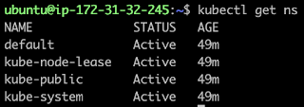
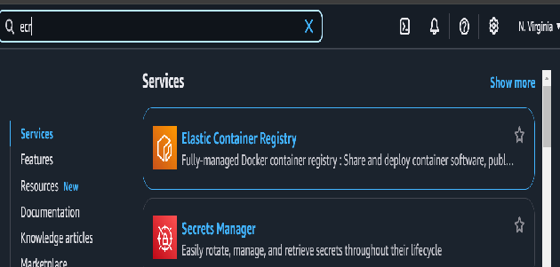
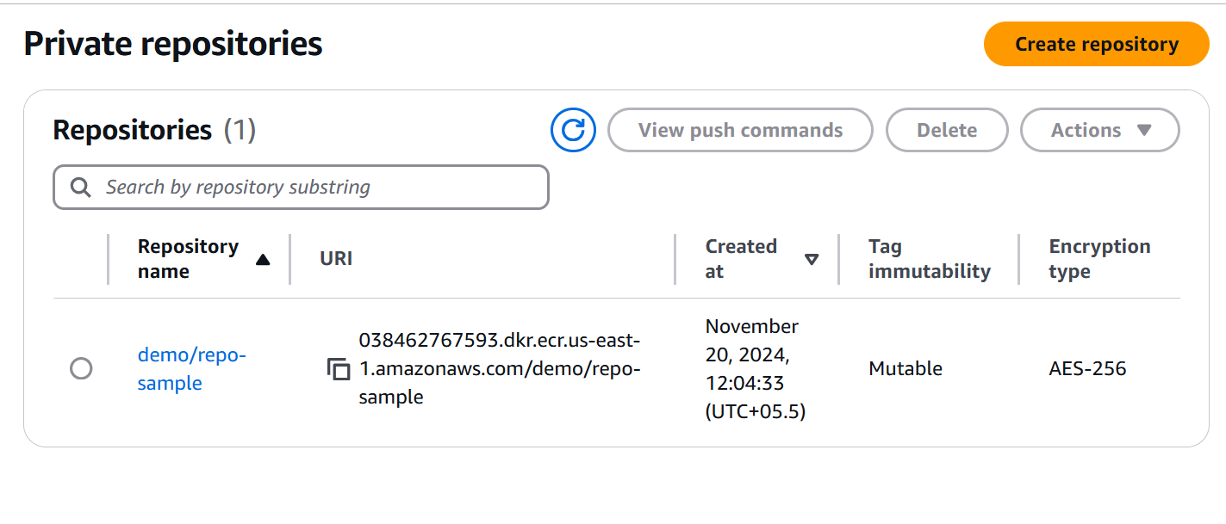
kubectl get ns Now Create repo in ecr:- Search for ECR in amazon console Create the repository and copy the URL

Slide 13
Now install Docker:- Docker installation steps using default repository from Ubuntu Update local packages by executing below command: →sudo apt update Install the below packages →sudo apt install gnupg2 pass -y gnupg2 is tool for secure communication and data storage. It can be used to encrypt data and to create digital signatures Install docker →sudo apt install docker.io -y Add Ubuntu user to Docker group →sudo usermod -aG docker $USER We need to reload shell in order to have new group settings applied. Now you need to logout and log back in command line or execute the below command: →newgrp docker

Slide 14
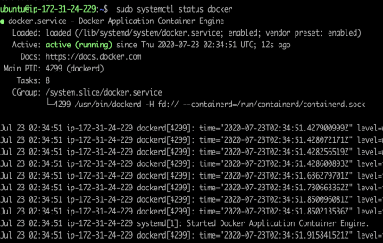
The Docker service needs to be setup to run at startup. To do so, type in each command followed by enter: sudo systemctl start docker sudo systemctl enable docker sudo systemctl status docker Docker Jenkins Integration | Building Docker Images using Jenkins - Every time developer makes code changes, you would want to Jenkins to automate Docker images creation and pushing into Docker registry.

Slide 15
Pre-requisites: Jenkins is up and running Docker is installed in Jenkins machine Install necessary plugins in Jenkins machine Docker plugin installed in Jenkins. Docker pipeline plugin installed in Jenkins. Kubernetes CLI plugin installed in Jenkins Now Login to Jenkins EC2 instance, execute below commands: Add jenkins user to Docker group →sudo usermod -a -G docker jenkins Restart Jenkins service →sudo service jenkins restart

Slide 16
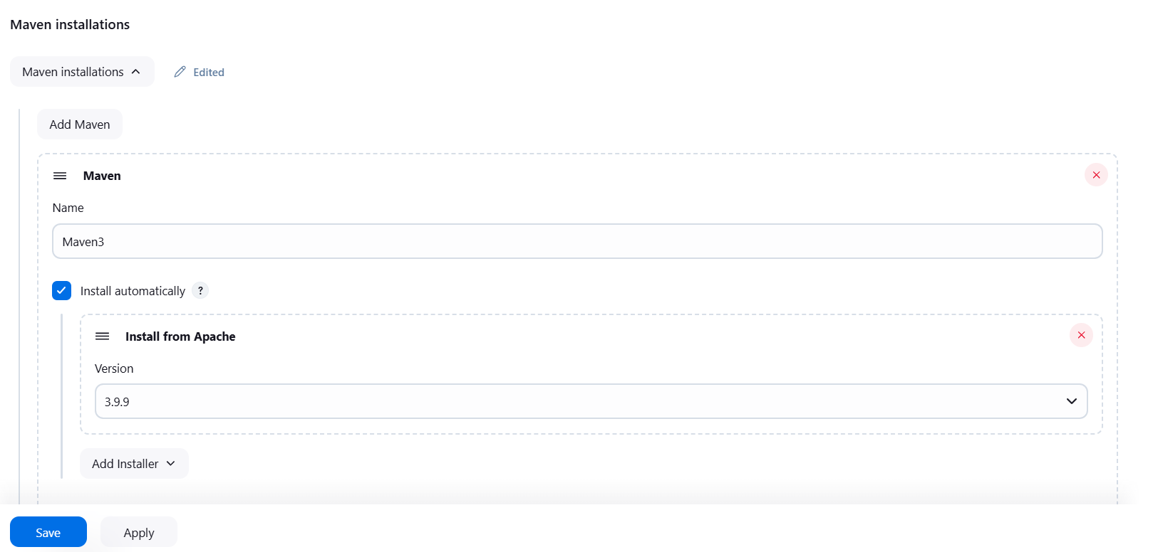
Reload system daemon files →sudo systemctl daemon-reload Restart Docker service as well →sudo service docker stop →sudo service docker start Create Maven Variable under Global and credentials in Jenkins dashboard:- Add the maven in tools Add the maven name and version (Latest version)

Slide 17
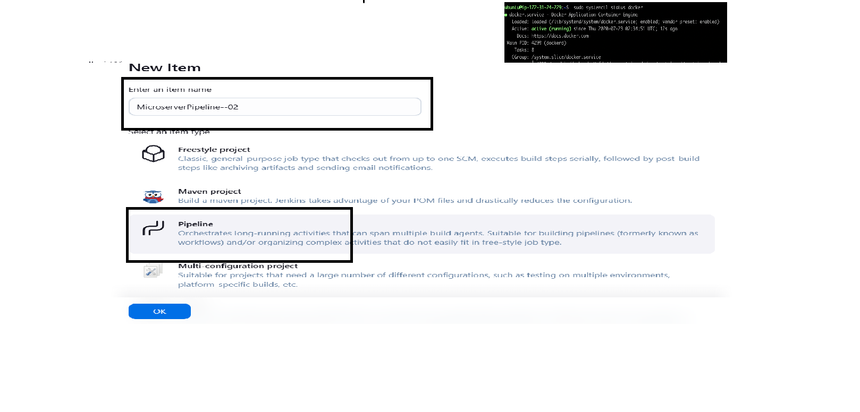
Now create a project in Jenkins dashboard → Select the new item and enter the name of the project → Select the Pipeline and click on OK

Slide 18
Select the pipeline script and enter the required pipeline data pipeline { agent any stages { stage('Checkout') { steps { checkout scmGit(branches: [[name: '*/main']], extensions: [], userRemoteConfigs: [[credentialsId: 'dockerhub_ID', url: 'https://github.com/sunildev03/MicroService-Core-Deploy.git']]) } } } } Click Apply and save then Build the code Pipeline

Slide 19
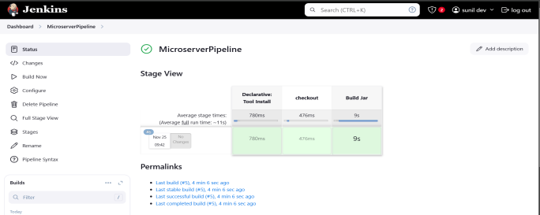
When Build get success it shows like below

Slide 20
Here the next stage is go back to the code and we have to add the jar files in the code so we have to configure the code to build the jar pipeline{ agent any tools { maven "Maven3" } stages { stage('checkout') { steps { checkout scmGit(branches: [[name: '*/main']], extensions: [], userRemoteConfigs: [[url: 'https://github.com/akannan1087/springboot-app.git']]) } } stage ('Build Jar') { steps { sh "mvn clean install" } } } }

Slide 21
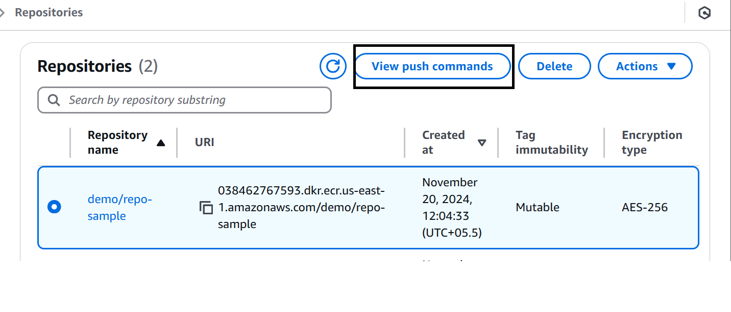
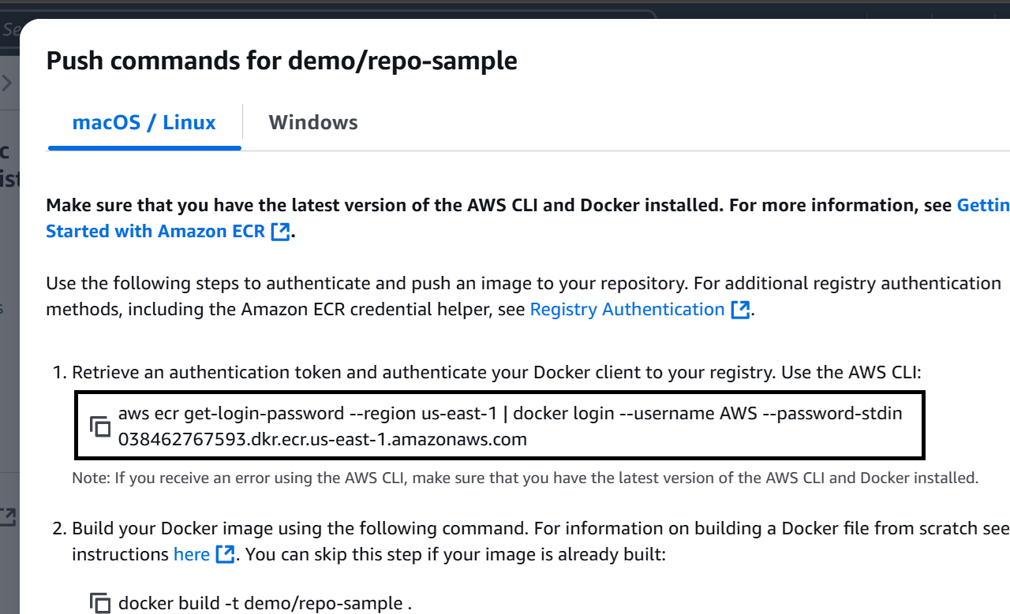
Now the next stage is we have to build the docker image:- Here we need to add the environment registry to the pipeline → To add the registry link search the ECR in Aws console and select the repository and open the view push commands Now copy the Docker registry link on the console

Slide 22
Now paste the URL in the pipeline to add the docker image pipeline{ agent any tools { maven "Maven3" } environment { registry = 038462767593.dkr.ecr.us-east-1.amazonaws.com/demo/repo-sample stages { stage('checkout') { steps { checkout scmGit(branches: [[name: '*/main']], extensions: [], userRemoteConfigs: [[url: 'https://github.com/akannan1087/springboot-app.git']]) } } stage ('Build Jar') { steps { sh "mvn clean install" } } stage ("Build Image") { steps { script { docker.build registry } } } } }

Slide 23
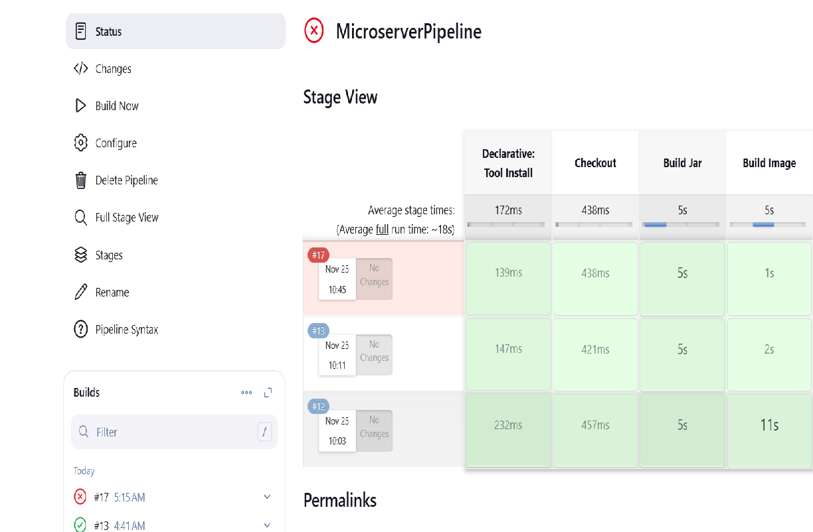
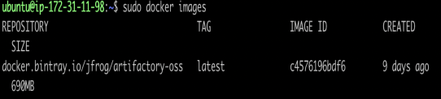
Click apply and save to build the pipeline Now check weather the docker image is created or not Now the another step is we have to push the docker image into ECR →Add the required pipeline data to push the docker image into ecr Cop →we can find the commands from the view push commands in ecr repository → Select the repository and open the view push commands then copy the required commands and paste the commands on the pipeline and run the pipeline

Slide 24
pipeline { agent any tools { maven "Maven3" } environment { registry = '038462767593.dkr.ecr.us-east-1.amazonaws.com/demo/repo-sample' } // Closing the environment block here stages { stage('Checkout') { steps { checkout scmGit(branches: [[name: '*/main']], extensions: [], userRemoteConfigs: [[url: 'https://github.com/akannan1087/springboot-app.git']]) } } stage('Build Jar') { steps { sh "mvn clean install" } }

Slide 25
stage('Build Image') { steps { script { docker.build(registry) } } } stage ("Push into ECR") { steps { sh "aws ecr get-login-password --region us-east-1 | docker login --username AWS --password-stdin 038462767593.dkr.ecr.us-east-1.amazonaws.com" sh "docker push 038462767593.dkr.ecr.us-east-1.amazonaws.com/demo/repo-sample:latest" stage("EKS Deploy"){ steps { withKubeConfig(caCertificate: '', clusterName: '', contextName: '', credentialsId: 'EKS', namespace: '', restrictKubeConfigAccess: false, serverUrl: '') { sh "kubectl apply -f eks-deploy-k8s.yaml" } } } stage } }

Slide 26
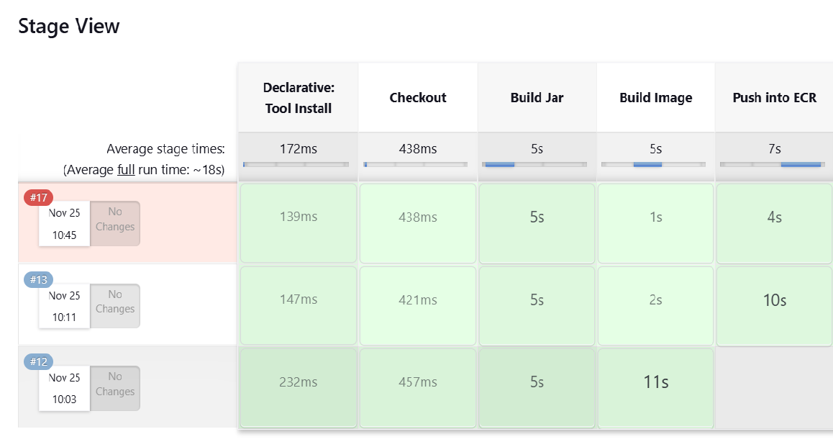
After the build got success the console output will be shown like below Now the last step is connecting to the cluster To check the cluster is running we use the command like eksctl get cluster --name demo-eks --region us-east-1 (cluster name and region should be add as per requirement)

